Slide 1

WELCOME BACK TO
MONEY BASICS
Facilitated by:
[Facilitator 1 name]
[Facilitator 2 name]

Slide 2
How to File Taxes & Resources for Doing So
Workshop 9
PG. 153 IN STUDENT GUIDE

Slide 3
Welcome Back!
Updates & Sharing:
How did the money saving homework go?
How are your budgets going?
Today’s Agenda:
Recognize that filing taxes can be confusing and stressful for many of us
Learn about why we file taxes, where our tax dollars go, and the difference between federal and state taxes
Learn about common tax forms and tax terms, and how to file a federal income tax return
Learn about free resources available to help someone file their state and federal tax returns
Learn about common tax deductions and tax credits
Learn about IRS payment options
Learn about tax extensions and back taxes

Slide 4
Community Agreements

Slide 5

Learning Objectives
Upon conclusion of Workshop 9, participants will:
Have a basic understanding of why we file taxes and the differences between state and federal taxes
Have a basic understanding of common tax forms and common tax terms
Understand the process of filing federal income tax returns and the information required to do so
Know new resources to help them file taxes
Know the different options for paying federal income taxes
Know how to get a tax extension and know the dangers of back taxes.

Slide 6

Taxes & Mental Health
What, if any, has your experience been with filing and paying taxes? How have taxes affected your mental health?

Slide 7
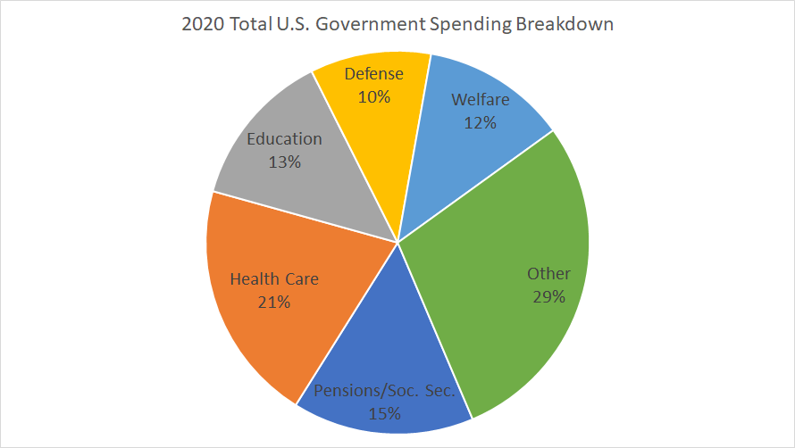
Tax Basics
Why do we pay taxes?
To support local, state, and federal infrastructure and public services.
What are some examples of infrastructure and public services that tax dollars provide?

Slide 8
Income Taxes
There are 3 types of taxes:
Taxes on the sales of certain goods and services
Taxes on workers’ paychecks and income – what we are focusing on
Taxes on people’s property and estates
Progressive tax systems: higher income brackets are taxed more than lower income brackets (the tax burden is higher for people with more money)
Flat tax systems: all income levels are taxed at the same rate
Regressive tax systems: higher income brackets are not taxed more, putting the tax burden on people with lower incomes

Slide 9
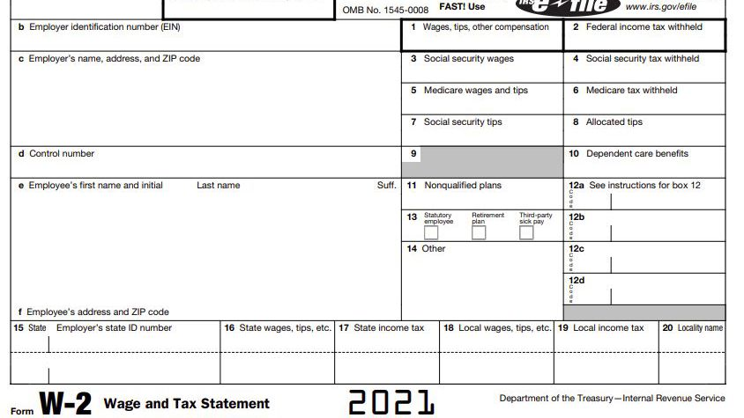
Common Tax Forms
W-2 Form
You’ll receive your W-2 form in the mail from your employer
Shows your payroll taxes (the amount in taxes withheld from your wages) and how much your employer paid you

Slide 10
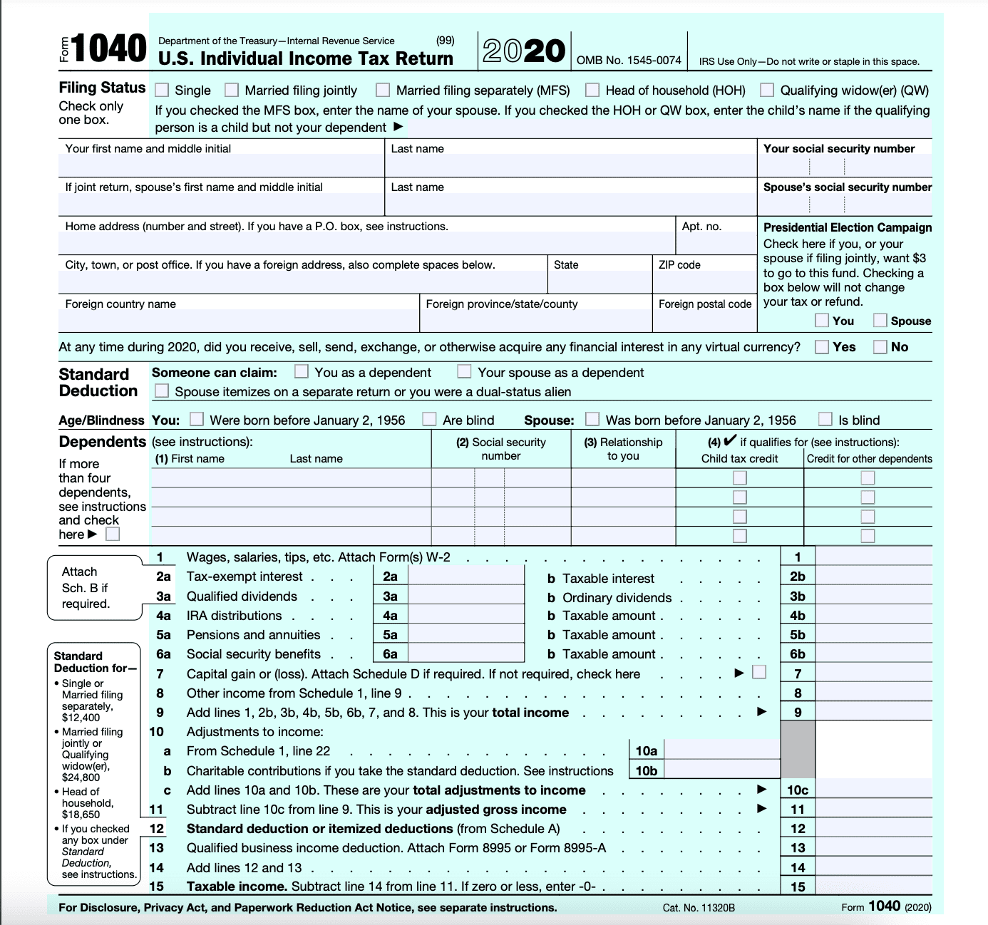
Common Tax Forms
Form 1040:
For filling out your federal income tax return each year
Calculates your total taxable income and determines how much should be paid to or refunded by the government

Slide 11
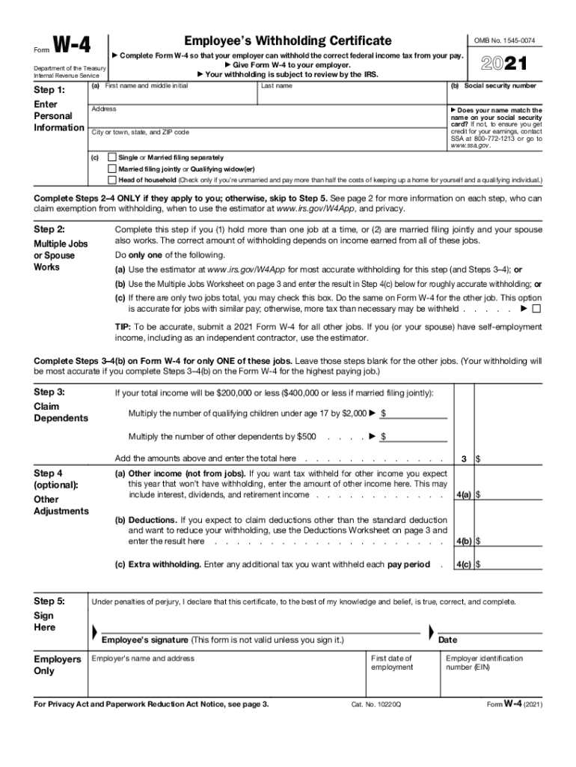
Common Tax Forms
W-4 Form
What you fill out when you start a job
You indicate the number of allowances you would like to claim and the amount of money you would like withheld
Helps your employer determine your withholding status
You also state your filing status, the number of dependents you will claim, and whether you work multiple jobs

Slide 12
Common Tax Terms
Filing Status: depends on your marital status and whether you are filing together or separately with your spouse
Deductions: reduce the amount of taxes you owe by lowering your total income
Standard vs itemized
Credits: also reduce the amount of taxes you owe
Earned Income Tax Credit (EITC)
Child Tax Credit
Dependent: a child or other relative a taxpayer cares for and can receive a tax exemption for
Self-employment tax: the portion of your income you owe to Social Security and Medicare if you are self-employed
Payroll taxes: taxes withheld by your employer from your paycheck

Slide 13

How to File a Federal Income Tax Return
Step 1: Gather required tax documents (W-2 form, receipts, other sources of income and expenses) and determine how much money you made the previous year
Step 2: Choose your filing status and decide if you are standardizing or itemizing your deductions
Step 3: Determine if you are claiming any dependents
Step 4: Determine any tax deductions and credits you may qualify for
Step 5: Decide how you’d like to file and submit your taxes (print forms and mail them, fill them out electronically, file with a tax filing service or provider, etc.)

Slide 14

Resources for Filing
IRS Free File
Volunteer Income Tax Assistance (VITA)
Tax Counseling for the Elderly (TCE)
Additional resources on the IRS website

Slide 15
Claiming Deductions and Credits
Common Deductions & Credits:
American Opportunity Tax Credit
Student Loan Interest Deduction
Lifetime Learning Credit
Child Tax Credit
Child and Dependent Care Tax Credit
Earned Income Tax Credit
Charitable Donations Deduction
Medical Expenses Deduction
Deduction for state and local taxes
Self-employment Expenses Deduction
Saver’s Credit
Educator Expenses Deduction
When to itemize vs take the standard deduction?
Choose the option that will save you the most money

Slide 16
Owing Taxes
Reasons for owing taxes instead of getting a tax refund:
Withholding too little from your paycheck
Filing late
Changes in tax code
Your income was higher than the previous year
Changes in deductions

Slide 17

Payment Options
Sign up for a payment plan
Request a temporary delay in collection
See if you qualify for an offer in compromise – a way to settle your debt for less than the full amount.

Slide 18
Other Important Things to Note
The IRS Tax Filing Deadline: April 15 or the next business day
Tax Extensions
You can request a tax extension from the IRS if you cannot file by April 15
Back Taxes
Taxes that have been partially or wholly unpaid the year they were due
Accumulate interest and penalties

Slide 19

Wrap-Up
Thank you all for your participation today!
Are there any questions?
Homework:
Choose one more money saving idea and commit to it for the week. Keep track of which ideas are going well and which are not.
Commit to using your personalized budget for the next week. Revise if needed.
Brainstorm any achievable financial goals you would like to save up towards.

